Slide 1
COMPUTER NETWORKS
CCP-CNS2026
Problem 1:
Multi-Site Enterprise Network
Apex Manufacturing
Team Members:
Rohma Shahbaz F2024266832
Muqadas F2024266841 | Muhammad Ahmad Ashraf F2024266539
Instructor: Sir Tahir Mehmood | UMT Lahore | Section V14

Slide 2
Problem Overview
Company
Apex Manufacturing
Departments
Sales, Engineering, Admin
Problem
Unsecured network with unauthorized access
Solution
VLANs + ACLs + DHCP + Attack Mitigation
Tool Used
Cisco Packet Tracer + Wireshark

Slide 3
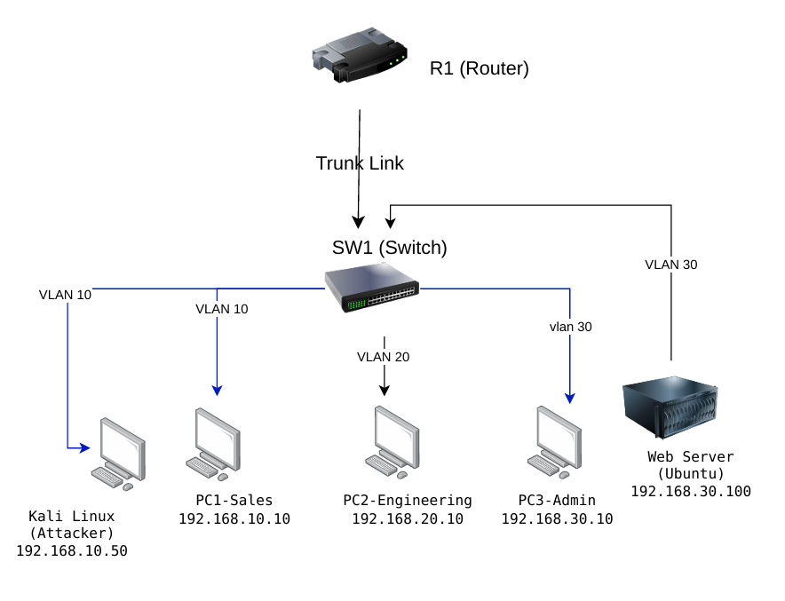
Network Topology
Devices
Router-on-a-Stick Topology
• Cisco Router 2911 (R1-ApexMfg)
[Insert Topology Diagram Here]
• Cisco Switch 2960 (SW1-ApexMfg)
• PC1-Sales — 192.168.10.10
• PC2-Engineering — 192.168.20.10
• PC3-Admin — 192.168.30.10
• Web-Server — 192.168.30.100
• Kali-Attacker — 192.168.10.50
* Replace with your draw.io diagram screenshot

Slide 4
IP Addressing Plan
VLAN
Department
Network
Subnet Mask
Gateway
Devices
10
Sales
192.168.10.0
255.255.255.0
192.168.10.1
PC1:.10, Kali:.50
20
Engineering
192.168.20.0
255.255.255.0
192.168.20.1
PC2:.10
30
Admin
192.168.30.0
255.255.255.0
192.168.30.1
PC3:.10, Server:.100
Router-on-a-Stick: One physical router port, three logical sub-interfaces (one per VLAN)

Slide 5
VLAN & Switch Configuration
VLAN 10 — Sales
Ports: Fa0/2, Fa0/6
VLAN 20 — Engineering
Ports: Fa0/3
VLAN 30 — Admin
Ports: Fa0/4, Fa0/5
Trunk Port: Gi0/1 → Router (carries all VLANs)
DHCP Snooping: Enabled on VLANs 10, 20, 30

Slide 6
Router Configuration
Router-on-a-Stick Sub-Interfaces:
Gi0/0.10
VLAN 10 (Sales)
192.168.10.1/24
Gi0/0.20
VLAN 20 (Engineering)
192.168.20.1/24
Gi0/0.30
VLAN 30 (Admin)
192.168.30.1/24
DHCP Pools Configured:
SALES (192.168.10.0/24) • ENGINEERING (192.168.20.0/24) • ADMIN (192.168.30.0/24)

Slide 7
Security Implementation
DHCP Snooping
Blocks rogue DHCP servers. Only router port (Gi0/1) is trusted.
ACL — SALES_SECURITY
Blocks Kali attacker IP and Sales VLAN from accessing Admin VLAN.
DoS Attack Simulation
1000 ICMP flood packets sent from Kali (192.168.10.50) to Web Server.
Attack Mitigation
100% packet loss on attacker side. All packets dropped by ACL.

Slide 8
Test Results
From
To
Expected
Result
PC1-Sales
Router Gateway
PASS
PASS ✓
PC1-Sales
PC2-Engineering
PASS
PASS ✓
PC1-Sales
PC3-Admin
BLOCKED
BLOCKED ✓
PC2-Engineering
Web-Server
PASS
PASS ✓
Kali-Attacker
Web-Server
BLOCKED
BLOCKED ✓

Slide 9
Conclusion
✓ Three VLANs created and verified for department isolation
✓ Inter-VLAN routing working via Router-on-a-Stick
✓ DHCP providing automatic IP addressing to all devices
✓ DHCP Snooping blocking rogue DHCP servers
✓ ACL blocking Sales VLAN from Admin VLAN
✓ DoS attack simulated and successfully mitigated
✓ Web server accessible to authorized departments only

Slide 10
Thank You
Questions?
GitHub: https://github.com/iamRohma/CNS2026-Problem1
Rohma Shahbaz | Muqadas | Muhammad Ahmad Ashraf

